Slide 1
November 2015
Microsoft Azure Cloud DevCamps
Vishesh Oberoi
Technical Evangelist, Microsoft
@ovishesh
visho@microsoft.com

Slide 2
Microsoft + Startups
BizSpark
BizSpark Plus
Microsoft Ventures

Slide 3



Microsoft Student Accelerator
Student Internships over Summer
Innovative Projects
Employer Registrations now open!
Register at http://msa.ms

Slide 4
Resources
aka.ms/Azure-DevCamp
github.com/ovishesh

Slide 5
Agenda
Time | Session | Time (mins) | Activity
9:00 to 10:00 | Intro to Azure | 40 | Presentation and Demos
 |  | 20 | Hands-on Lab
10:00 to 10:20 | Morning Tea | 20
10:20 to 12:00 | Azure App Service | 20 | API - Presentation and Demos
 |  | 20 | Web - Presentation and Demos
 |  | 45 | Hands-on Labs
12:00 to 13:00 | Lunch | 60
13:00 to 14:15 | Azure AD and API Management | 30 | Presentation and Demos
 |  | 45 | Hands-on Labs
14:15 to 15:15 | Azure IaaS | 30 | Presentation and Demos
 |  | 30 | Hands-on Labs
15:15 to 15:30 | Evening Tea | 20
15:30 to 16:30 | Data Overview | 30 | Presentation and Demos
 |  | 30 | Hands-on Labs - DocumentDB
16:30 | Closing

Slide 6
The Cloud for Modern Business
Vishesh Oberoi
@ovishesh
Notes:
Everyone is going through a Transformation, including us!

Slide 7



Empower every person and every organization on the planet to achieve more
Build the intelligent cloud
Reinvent productivity & business process
Create more personal computing
Notes:
Goal of slide: Transition to setting up the keynote, using 3 ambitions
TPs
Empowering every individual and organization is a bold ambition and has required us to push our platforms forward in bold new ways
We will build the intelligent cloud - in a world where devices will out number people and data is growing exponentially there is a huge opportunity to build intelligent cloud solutions
We will reinvent productivity and business processes – We no longer need a set of individual productivity apps –we need a platform that enables a rich set of social/mobile experiences
We will create more personal computing – MPC
Never been a better time to be a part of the MS ecosystem as a dev

Slide 8


Platform opportunity
Build the intelligent cloud
Reinvent productivity & business process
Create more personal computing
Notes:
Goal of slide: Transition to setting up the keynote, using 3 ambitions
TPs
Empowering every individual and organization is a bold ambition and has required us to push our platforms forward in bold new ways
We will build the intelligent cloud - in a world where devices will out number people and data is growing exponentially there is a huge opportunity to build intelligent cloud solutions
We will reinvent productivity and business processes – Office is no longer a set of individual productivity apps – Office is a platform that enables a rich set of social/mobile experiences
We will create more personal computing – Windows 10 is a major step forward

Slide 9
Why the cloud?

Slide 10
Why the cloud?
Speed
Scale
Economics
Notes:
So in a nutshell Cloud is all about:
Speed - Rapidly setup environments to drive business priorities
Scale - Scale to meet peak demands
Economics - Increase daily activities, efficiency and reduced cost.

Slide 11



Cloud Computing
IaaS
PaaS
SaaS
Infrastructure-as-a-Service
Platform-as-a-Service
Software-as-a-Service
host
build
consume

Slide 12
Why the cloud?
Hosting models
Business model
On Premises
Infrastructure
(as a Service)
Platform
(as a Service)
Software
(as a Service)
Applications
Applications
You manage
Applications
Applications
You scale, make resilient and manage
You scale, make
resilient & manage
Data
Data
Data
Data
Runtime
Runtime
Runtime
Runtime
Scale, resilience and management by vendor
Middleware
Middleware
Middleware
Scale, resilience and management by vendor
Middleware
O/S
O/S
O/S
O/S
Virtualization
Virtualization
Managed by vendor
Virtualization
Virtualization
Servers
Servers
Servers
Servers
Storage
Storage
Storage
Storage
Networking
Networking
Networking
Networking

Slide 13
SaaS Solutions
Differentiation
Agility
Cost
Cloud Infrastructure
Journey to the Cloud
Higher-level services
Notes:
Lets go back to the Microsoft Story.
We are in the midst of shift in the way we do general computing, and it’s a major shift for everyone – Microsoft included.
Every org will also be transforming sooner, than later.
They will be using SaaS solutions to achieve faster time to value.
They are going to extend their existing DCs with the help of Cloud Infrastructure and Compute to improve cost savings and agility.
They are going to take advantage of higher level services like ML and CAS to engage better with their customers and get more insights into their own business that will help them reinvent their business processes and get a differentiated advantage.
This will inturn help them enable real business transformation.

Slide 14
Azure

Slide 15

Leading the journey to the Cloud
Microsoft Enterprise Mobility Suite
Notes:
We offer the most comprehensive set of SaaS applications.. That’s deployed and used by more businesses
In IT EMS helps us manage that without compromising the UX and making sure that we don’t harm the security.

Slide 16
Leading the journey to the Cloud
SAAS Solutions
Microsoft Dynamics
Enterprise Mobility
Microsoft Enterprise Mobility Suite
Microsoft Azure
Developer + App Platform
Visual Studio Family + Azure App Service
Data + Analytics
Cortana Analytics Suite
Internet of Things
Azure IoT Suite
Cloud Infrastructure
Azure + Azure Stack + Operations Management Suite
Notes:
AWS – Iaas, but no paas or saas
Salesforce – SaaS, but no other
TP is Azure not PaaS or IaaS..

Slide 17

24
Azure regions around the world
Hyper-scale footprint
More than AWS and Google Cloud combined
Azure regions

Slide 18
Hyper-scale
Azure
Enterprise proven
Hybrid

Slide 19
Hybrid
Hyper-scale
Enterprise proven
Hybrid
Hybrid
On-premises
Azure Stack
Notes:
Talk about Gartner Survey
10% - Public Cloud
10% - Hosted environments
80% - Hybrid Cloud

Slide 20
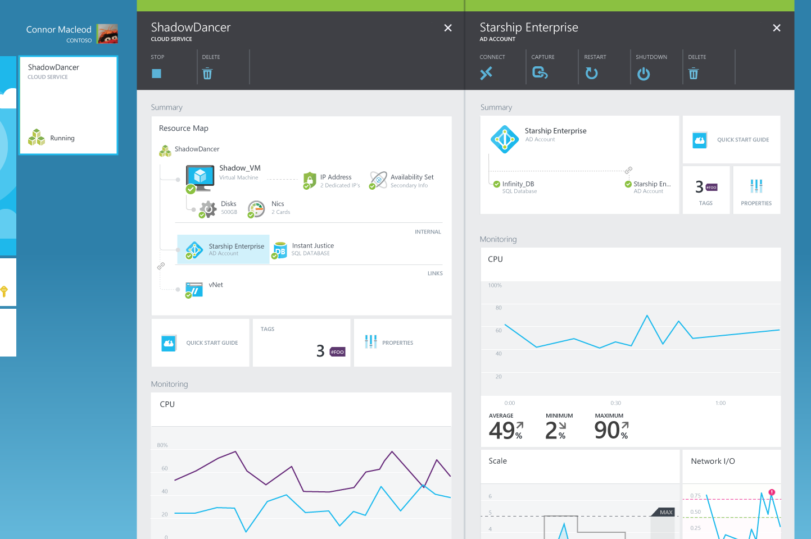
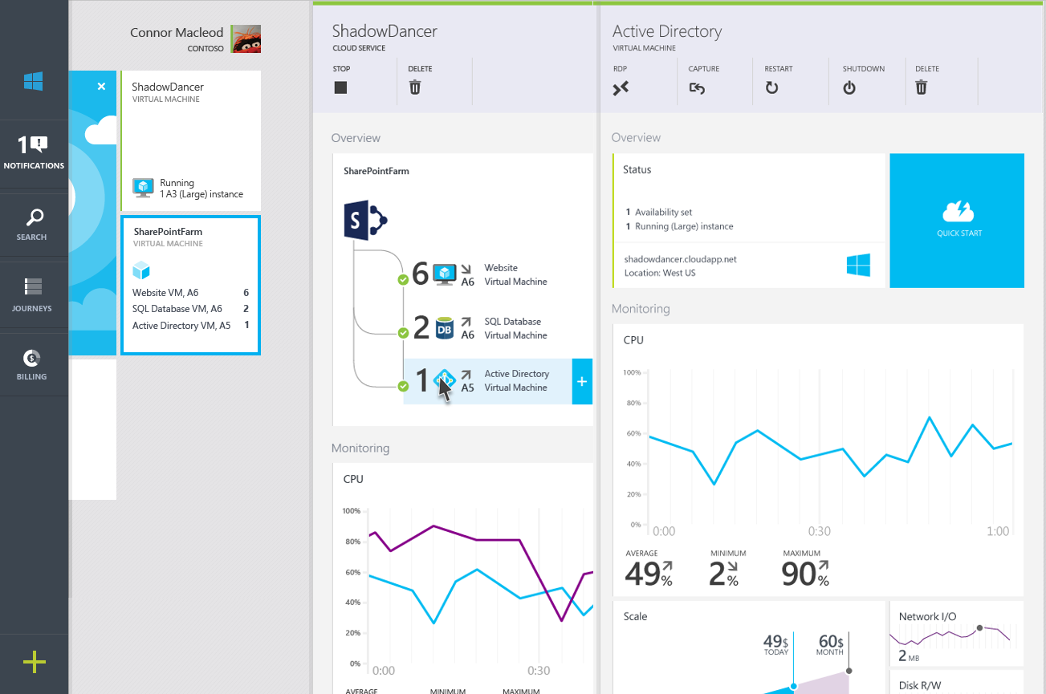
Hybrid consistency
CUSTOMER DATACENTER
CONSISTENT PLATFORM
MICROSOFT AZURE
SERVICE PROVIDER
Common OS and Hypervisor
Common management API/UX
Common programming model

Slide 21

Connect every on-premises server to the cloud
Azure
StorSimple
Backup
Hyper-V Disaster Recovery
VMWare Disaster Recovery
SQL Server Always On
Active Directory
Orchestration as a Service
ExpressRoute Networking
On-Premises Datacenter

Slide 22




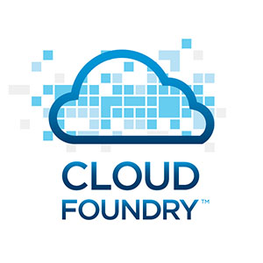
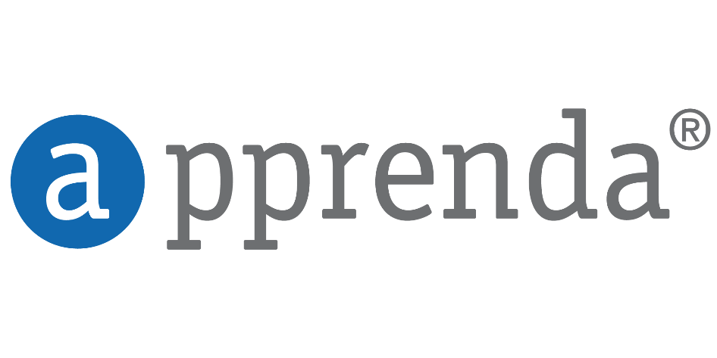















Open + Flexible
Management
Hyper-scale
Open & flexible
Applications
Enterprise proven
App Frameworks
Hybrid
Databases & Middleware
Infrastructure
Linux

Slide 23





Dev + IT productivity
Developer & IT productivity
Visual Studio
GitHub
Eclipse
Chef + Puppet
Powershell
Hyper-scale
Open & flexible
Enterprise proven
Hybrid

Slide 24

SaaS extensibility
Developer & IT productivity
Hyper-scale
Open & flexible
Enterprise proven
Hybrid
Platform for SaaS extensibility

Slide 25


























Trustworthy
More compliance certifications than any other cloud
Developer & IT productivity
Hyper-scale
Open & flexible
Enterprise proven
Trustworthy
Hybrid
Trustworthy
Platform for SaaS extensibility

Slide 26





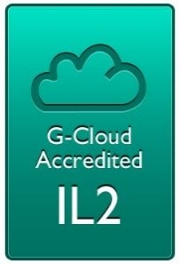

Compliance: aka.ms/AzureCompliance
Notes:
Speaker notes:
Azure meets a broad set of international and industry-specific compliance standards, such as ISO 27001, HIPAA, FedRAMP, SOC 1 and SOC 2, as well as country-specific standards including Australia IRAP, UK G-Cloud, and Singapore MTCS.
Azure cloud services, with independently verified compliance, give you the foundation to achieve compliance for the infrastructure and applications you run in Azure.
Azure is subjected to rigorous audits by independent organizations and the results are available to you as a part of Microsoft's commitment to transparency.
Microsoft was also the first to adopt the uniform international code of practice for cloud privacy, ISO/IEC 27018, which governs the processing of personal information by cloud service providers.

Slide 27
>90,000
New Azure customer subscriptions/month
>1.5Million
SQL Databases running on Azure
>500Million
Users in Azure Active Directory
Azure momentum
1.5Trillion
Messages per month processed by Azure IoT
777Trillion
Storage Transactions per day
>40%
Revenue from Start-ups and ISVs
Notes:
>85% F500 customers on MS Cloud
>3,400 apps in Azure Marketplace
30 major certifications and attestations — more than any other major public cloud provider
13B authentications supported every week by Azure cloud services
1T messages a month are processed using Event Hub
>60B ingress events per day worldwide in Even Hub
More than 70T storage objects in Azure
More than 9M transactions per second processed by Azure Storage (nearly 3x growth YoY)
1.5M SQL DBs under management in Azure / Customer usage has increased 7x YoY
2.5B logins per week process to Azure SQL DB
External Traffic / web site hits (e.g. customer traffic only)- 83.46 billion hits/month
Total Sites/Apps (customer sites only) – 664k
3.4M Developers registered with Visual Studio Online

Slide 28




























>80% of Fortune 500 use the Microsoft Cloud
Notes:
$1B in Revenue (compared to XX 3 years ago)
Only vendor as a leader in all 4 Gartner Cloud Infrastructure MQ's
>90K new customer subscriptions / month
80% of Fortune 500 customers use MS Cloud (or 58% use Azure)
23 regions announced globally, over 2x the number of AWS regions and 8x Google (3 Regions).
One of the largest networks in the world. We connect to over 1700 networks and have 1.4M miles of fiber in our datacenters
Azure has 22 major certifications and attestations-- more than any other major public cloud provider
Microsoft a Leader in Gartner Magic Quadrants
Cloud Infrastructure as a Service (May 2015)
Application Platform as a Service (March 2015)
Public Cloud Storage Services(June 2015)
X86 Server Virtualization(July 2014)
IDC predicts that 65% of enterprises will commit to hybrid cloud before 2016
Equifax (CPS – US)
details to come from Mark Jewett
Garuda: (Linux – APAC)
Garuda is Indonesia's national airline. They had a locally hosted e-Commerce web application built on open source technologies (PHP, MySQL and Linux Cent-OS Linux) that experienced repeated crashes and security breaches
Azure team stepped in and helped them lift and shift their solution to Azure in two weeks, without the need to re-architect their solution.
68% of the total consumption revenue(~400K) comes from OSS running on Azure
Tax Authority of Mexico (IaaS – LATAM) (SAT)
The Tax Authority of Mexico is the government entity responsible for collecting taxes from 46,3 million taxpayers in Mexico.
The Tax Authority of Mexico (SAT) wanted to upgrade its technology infrastructure to serve the growing demands of 40 million taxpayers who, as a result of changes to local legislation, had to interact electronically with the entity. SAT shifted to the cloud, using Microsoft Azure and other technologies to improve online service levels for citizens and businesses, increase tax control and tax collection, and reduce processing time and tax evasion
SAT wanted to replace its outdated systems and use new IT tools to establish more efficient, modern management processes for increasing tax collection, reducing tax evasion, supporting high data flows, serving hundreds of thousands of employees and taxpayers in simultaneous sessions, and offering those users better service through a simple tax-payment platform.
By using Microsoft Azure, SAT has been able to establish a modern technology environment that offers multiple online services simultaneously to millions of Mexicans, who must make transactions related to tax payment.
SAT works with AWS, IBM, Oracle, and others as part of their multi-vendor strategy. The account team (Raul Flores) having gained the trusted relationship with CIO was able to showcase the power and impact of Azure over other competitive technologies to win this deal

Slide 29

Titanfall
→ Game sessions hosted using Azure
→ Hosted using >100,000 Azure Virtual Machines
Notes:
Points to land:
Imagine what you could do…
→ 360,000 concurrent cores
→ Have EA tell the story
→ Assume we don't run out of capacity

Slide 30

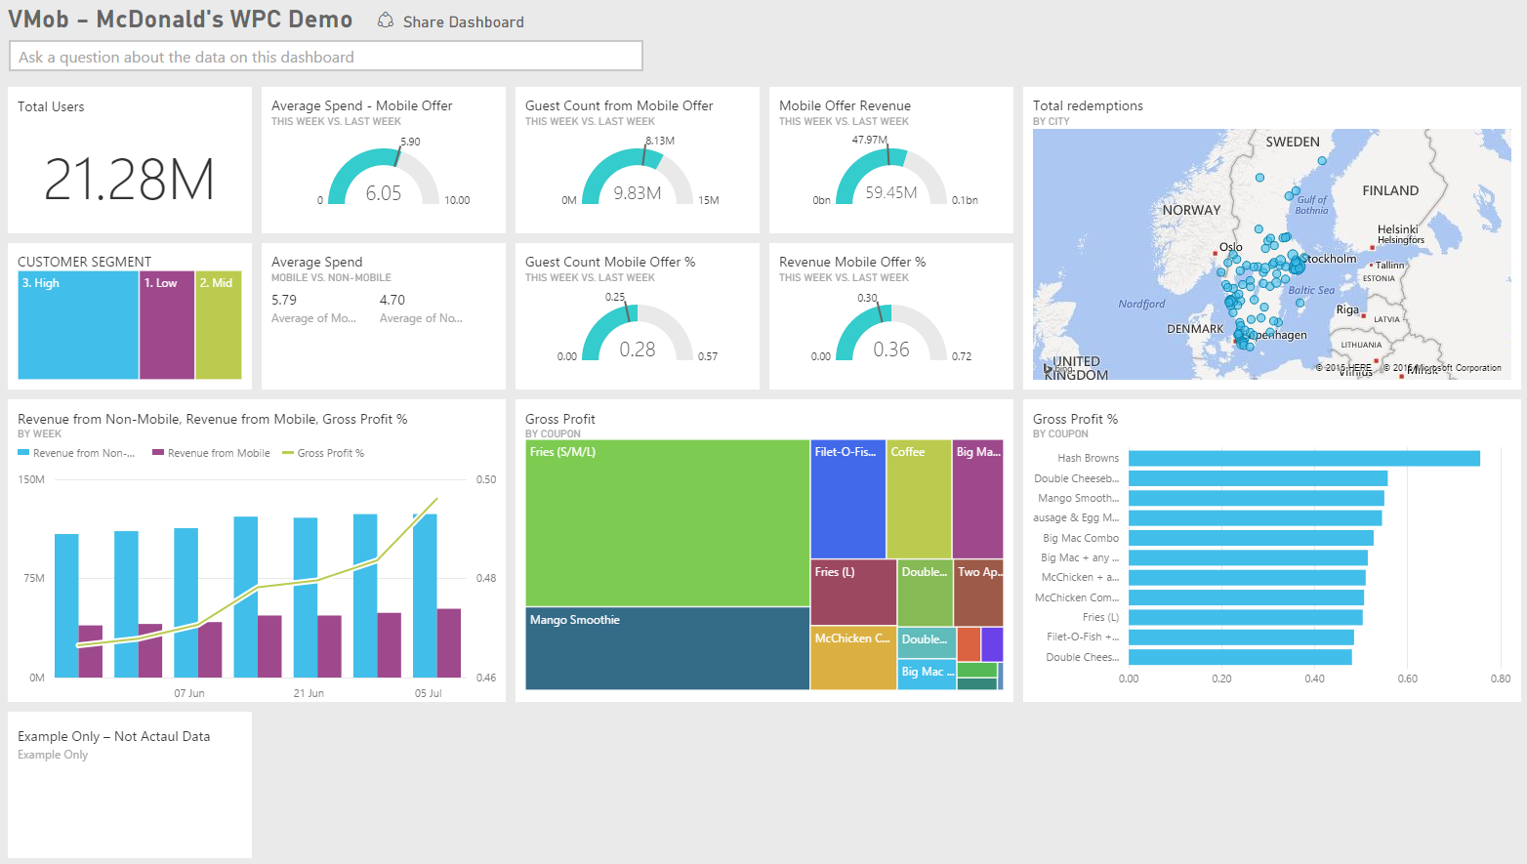
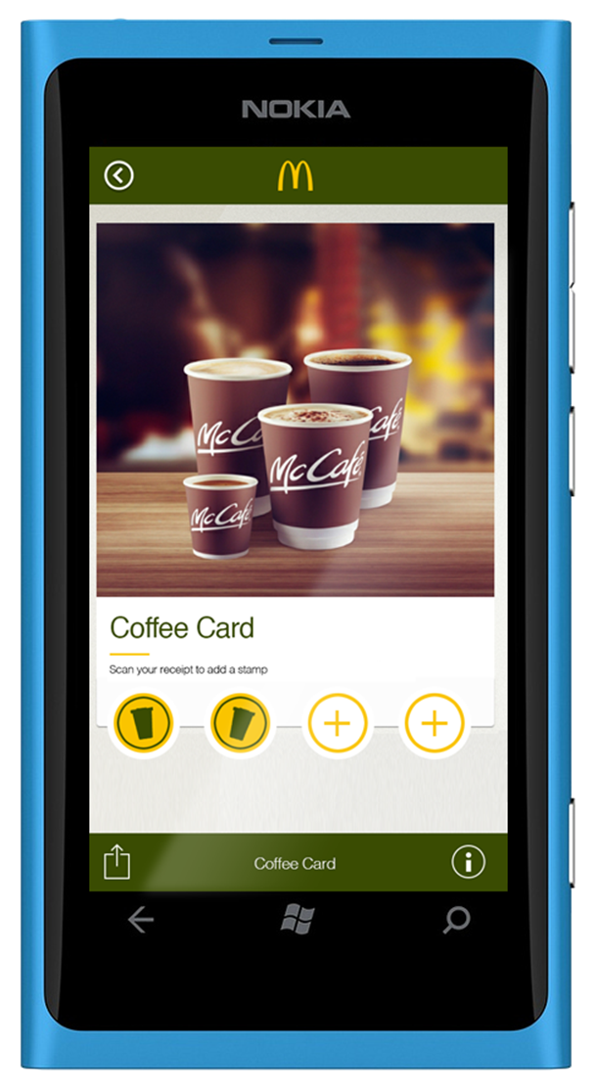
McDonalds
Portal – Power BI
http://portal.powerbi.com
IoT analytics solution used by McDonalds to increase daily customer traffic and drive an uplift in revenue.
VMob delivers an intelligent personalization platform built using Microsoft Azure and Power BI.
Scott Bradley CEO, VMob
Not actual customer data

Slide 31
Leading the journey to the Cloud
Microsoft Azure
Developer + App Platform
Visual Studio Family + Azure App Service
Data + Analytics
Cortana Analytics Suite
Internet of Things
Azure IoT Suite
Cloud Infrastructure
Azure + Azure Stack + Operations Management Suite

Slide 32
Azure StorSimple
Azure in Open
Azure Government
Azure SQL Database
Rights Management (RMS)
Azure API Management
Azure Site Recovery
Azure Automation
Instance Level Public Ips
Azure Redis Cache
Azure Batch
Azure Marketplace
Azure Data Factory
Stream Analytics
Event Hubs
Operational Insights
Premium Storage
Virtual Machine Converter 3.0
Cloud Platform System (CPS)
Antimalware for Cloud Services and VMs
Identity Manager vNext
Analytics Platform System (APS)
Visual Studio Community 2013
Visual studio 2015 Preview
.NET 2015
Azure RemoteApp
Azure AD Basic
SSD-based instances for Microsoft Azure VMs and Cloud Services
Azure SQL Database Auditing
Live Channels for Azure Media Services
AAD Application Proxy
New experiences in Power BI
Azure DocumentDB
Azure Search
HDInsight for Storm Public Preview & GA
Azure Zone Redundant Storage
HDInsight for Hbase
WSSC vNext tech preview
Content Protection pub preview
Intune - Nov update and Dec update
Azure AAD premium features
Multi-Factor Auth enhancements
Cloudera and Hortonworks on clustered Azure VMs
Azure Instance level IP
Azure Role Based Access Controls
VPN support pub preview
TiP Testing pub preview
Azure AD Workday A148 Integration
Azure Standard SSG
ExpressRoute S2S, P2S GA
Azure Multiple NICs
Azure Networking Appliances
Azure Traffic Manager Nested policies
Azure VM Image Gallery expansion
Azure Vnet
Azure Web Jobs
VSO datacenter expansion
VSO REST Hooks pub preview
Australia datacenter
Forced Tunneling
WSSC Azure Packs
Azure G-Serves Instances
Azure Key Vault
Drivers for SQL Server
MDM for Office 365 public preview and GA
Azure Media Services Content Protection
Azure Mobile Engagement
Node.js Tools for Visual Studio
Visual Studio 2013 updates
Auto-HA for SQL Server VM
Auto-Patching and Backup for SQL Server VMs
Azure SQL Database Increased Compatibility
Azure AD Connect Health pub preview
Azure AD MFA Per App / Conditional access pub preview
Azure RMS controlled user deployment
Azure RMS departmental templates pub preview
Azure Site Recovery SAN Replication
ASP.NET 5 Preview
Azure SDK 2.5.1
Team Foundation Server 2015 preview
Azure Machine Learning GA
Azure HDInsight for Linux Pub Preview
Azure HDInsight Support for Hadoop 2.6 pub preview
Azure SQL Database security feature - Data Masking pub preview
Azure SQL Database security features - Encryption
Azure SQL Database security features - Row Level security
Azure AD: API for SIEM
Microsoft Intune monthly updates
Remote Desktop Client for Windows Phone 8.1
Azure App Service
Azure CDN Integration
Azure Media Encoder Premium
Azure AD Premium & Basic in CSP
Azure IoT Suite
Windows Server Containers
Hyper-V Containers
Windows Server Nano Server
Azure Media Player GA
Azure Service Fabric
Azure IoT Suite
Azure Site Recovery: Protect VMWare and Physical Servers in Public Preview
Azure Backup Generally Available
Azure API Management Premium simplifies high availability and massive scale for APIs
ExpressRoute for Office 365
Azure Active Directory Dynamic Membership For Groups
Automatic Password Change for Social Media Shared Accounts
Compute-Intensive A10 and A11 Virtual Machine Instances
Remote Desktop app for Windows Phone support for Gateway and Remote Resources
Informatica Cloud Agent availability in Linux and Windows Virtual Machines
Azure DocumentDB Hadoop Connector
Azure HDInsight support for more VM sizes
Enterprise-Grade Array-Based Replication and Disaster Recovery with ASR and System Center GA
500+
New releases in
the last 12 months
Notes:
112

Slide 33












Microsoft Azure
Leading the journey to the Cloud
Developer + App Platform
App Platform Services
Integration
Development Tools
Media & CDN
SAAS Solutions
Microsoft Dynamics
Content Delivery Network
App Service
Storage Queues
Visual Studio
Microsoft Azure
Notification Hubs
BizTalk Services
Visual Studio Online
Media Services
Enterprise Mobility
Microsoft Enterprise Mobility Suite
Developer + App Platform
Visual Studio Family + Azure App Service
API Management
Hybrid Connections
Application Insights
Cortana Analytics Suite
Data + Analytics
Service Fabric
Service Bus
Azure SDK
Cloud Services
Internet of Things
Azure IoT Suite
Cloud Infrastructure
Azure + Azure Stack + Operations Management Suite

Slide 34


Azure App Service Build and scale great cloud apps
Web Apps
Mobile Apps
Logic Apps
API Apps
Notes:
Web Apps – web apps that scale per your needs
Mobile Apps – Backend for any of your mobile apps
Logic Apps – Automate business processes across SaaS and on-prem
API Apps – Easily build and consume APIs in the cloud

Slide 35










Microsoft Azure
SAAS Solutions
Microsoft Dynamics
Data + Analytics
Data
Analytics
Enterprise Mobility
Microsoft Enterprise Mobility Suite
SQL Database
SQL Data Warehouse
HDInsight
Data Factory
DocumentDB
Data Lake
Machine Learning
Mobile Engagement
Developer + App Platform
Visual Studio Family + Azure App Service
Redis Cache
Tables
Search
Data + Analytics
Cortana Analytics Suite
Internet of Things
Azure IoT Suite
Cloud Infrastructure
Azure + Azure Stack + Operations Management Suite

Slide 36

SQL Database
Fully managed SQL Server database technology as a service
Ideal for simple and complex applications
Enterprise-ready with automatic support for HA
Secondary
Replica
Primary
Secondary
Replica
Secondary
Replica
Notes:
Speaker notes:
How is HA achieved? At any one time, three database replicas are running—one primary replica and two or more secondary replicas. If the hardware fails on the primary replica, Azure SQL Database detects the failure and fails over to the secondary replica. In case of a physical loss of a replica, a new replica is automatically created. So there are always at minimum two physical, transitionally consistent copies of your data in the datacenter.

Slide 37

Big Data Insights
Microsoft Azure HDInsight
Microsoft instance of Hadoop distribution running as service
Support existing ecosystem from Hive, Pig, etc
Includes HBase and Storm
Extended to support Excel and BI tooling
Integration with diverse sources of data
Notes:
Speaker notes.
HDInsight is Microsoft instance of Apache Hadoop distribution running as a service in Azure cloud that you can spin up in minutes. It’s architected to handle any amount of data, scaling from terabytes to petabytes on demand.
Supports existing ecosystem such as Hive to explore your data or to create reusable batch processing jobs. Includes Pig to implement complex processing logic.
Uncover business insights by processing and analyzing structured or semi-structured data from web clickstreams, social media, server logs, devices and sensors, and more.
Because it's integrated with Excel, HDInsight lets you visualize and analyze your Hadoop data in compelling new ways in a tool familiar to your business users.
Includes NoSQL transactional capabilities with Apache Hbase. Provides real-time stream processing capabilities with Apache Storm
Leverage existing skills for configuration, submission, and monitoring of Hadoop jobs using languages you know such as Java, C#, PowerShell, .Net SDK

Slide 38
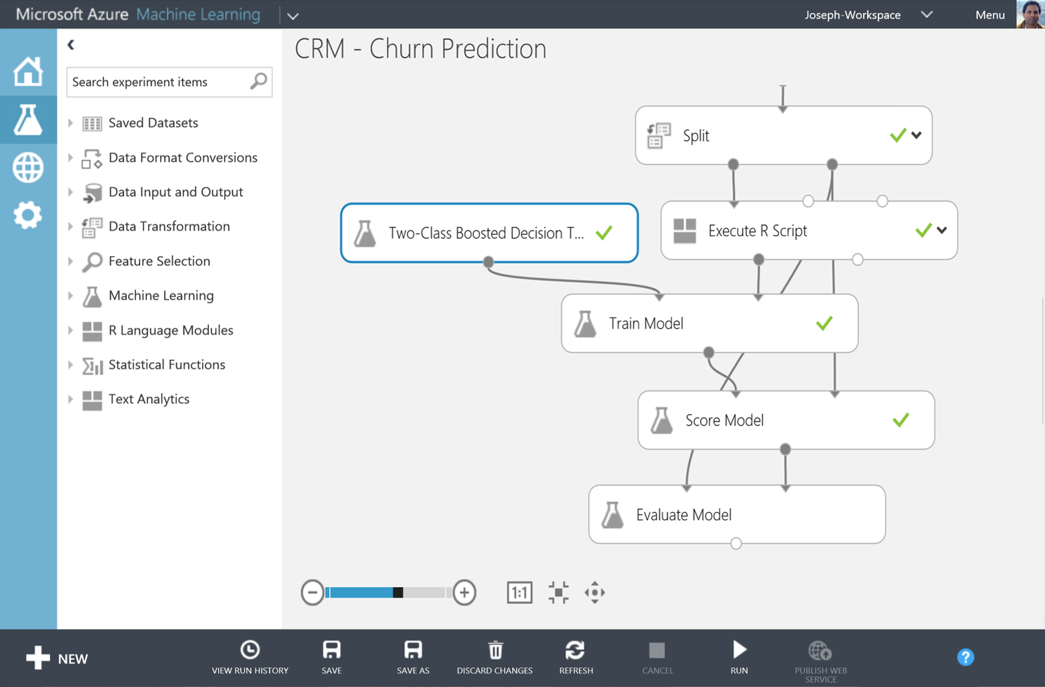
Big Data Insights
Microsoft Azure Machine Learning
Democratized platform for Machine Learning
Fully-managed cloud service for building predictive
analytics solutions
Elastic, pay as you go with low operating costs
Extend with Power BI, HDInsight and cloud hosted data
Extensible, supports R and Python
Notes:
Speaker notes:
Democratized; Azure Machine Learning lets the masses and scientists alike learn, experiment, mashup and create high quality powerful algorithms.
Visually compose ML workflow through a web browser with no software to install and without learning multiple tools from data acquisition, cleaning and prep, machine learning, and experimentation.
Fully-managed cloud service for building predictive analytics solutions, helps overcome the challenges most businesses have in deploying and using machine learning.
Enables data scientists and developers to efficiently embed predictive analytics into their applications.
Azure ML is supports today’s Data scientists’ choice of language R and can bring their existing assets in R and integrate them seamlessly into Azure ML workflows.

Slide 39
Intelligent action
What happened?
Why did it happen?
What will happen?
What should I do?

Slide 40
Power BI
Machine Learning
SQL Data Warehouse
HDInsight
Data Lake Analytics
Data Lake Store
Stream Analytics
Data Factory
Data Catalog
Event Hubs
Information management
Big Data stores
Machine Learning
Analytics

Slide 41

Introducing Cortana Analytics Suite

Slide 42

Microsoft Azure
SAAS Solutions
Microsoft Dynamics
Enterprise Mobility
Microsoft Enterprise Mobility Suite
Developer + App Platform
Visual Studio Family + Azure App Service
Internet of Things
IoT Hub
Stream Analytics
Logic Apps
Data + Analytics
Cortana Analytics Suite
Internet of Things
Azure IoT Suite
Cloud Infrastructure
Azure + Azure Stack + Operations Management Suite

Slide 43

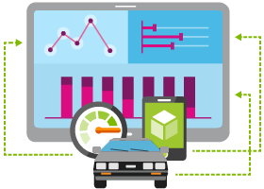

Internet of Things
Event Hubs
Notification Hubs
Stream Analytics
Machine Learning
HDInsight
Power BI for Office 365
With Microsoft Azure IoT services, you can monitor assets to improve efficiencies, drive operational performance to enable innovation, and leverage advance data analytics to transform your company with new business models and revenue streams.
Notes:
Speaking Notes
Azure Mobile Services is a Backend-as-a-Service
Instead of you having to design, build, test, deploy, manage, and upgrade your whole backend, we do it for you
Features of Mobile Services
Storage – SQL DB
Authentication – built in support for social providers w/ ability to custom auth
Backend logic – data validation, logical flows, etc
Push Notifications – across all major mobile platforms
Scheduler – backend job processing

Slide 44
Things
Now Available to Purchase Azure IoT Suite
Device Connectivity and Security
Data Ingestion and Command & Control
Stream Processing & Predictive Analytics
Workflow Automation
Dashboards and Visualization
Preconfigured Solutions
Notes:
Talking Points:
With Azure IoT Suite we give you a very comprehensive solution that’s designed to help you connect your devices, whether a few hundred or millions across the world, analyze all the data coming from these devices and take action from the insights by integrating with your back end systems. IoT Suite bring together and offer the following capabilities:
Device connectivity and security: Connect to millions of devices simultaneously. Enhance security of your IoT solutions by taking advantage of per-device authentication to communicate with devices that have the appropriate credentials. Revoke access rights to specific devices to maintain the integrity of your system.
Data Ingestion & Command & Control: Establish reliable, bi-directional communication with these assets, even if they are intermittently connected, and analyze—and act on—incoming telemetry data.
Workflow automation: Integrates with your company’s existing back-end systems to enable you to make the best use of the data and processes you already have. Whether it’s as simple as sending a text or integrating with your CRM or EPP system
Dashboards & Visualization: Create powerful and rich visualization experience and finally
Preconfigured solutions: One of the biggest value we can provide is helping you develop IoT solutions faster. This will not only allow you to do more PoCs and pilots, it will also help accelerate the long project cycles we spoke about earlier. We do this by offering preconfigured solutions for the more common IoT scenarios.

Slide 45
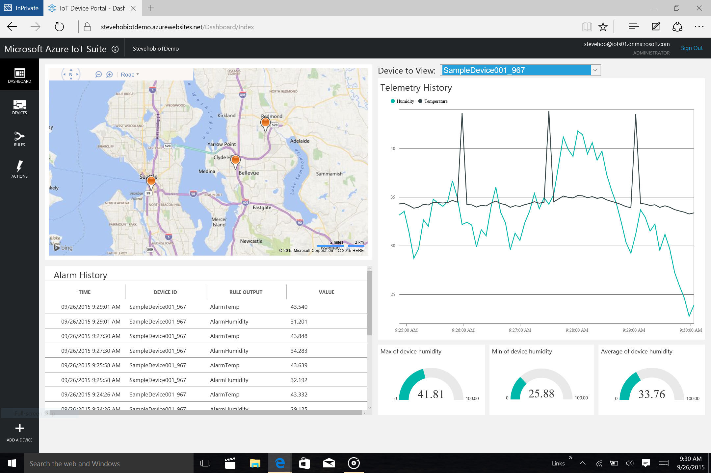
Notes:
Talking Points:
You are taken to a list of devices, where you can ping a device, send a command, turn device on or off, and set threshold for a specific device thru adding rules.
You can also add a device (bottom left corner + sign), and we given you the option to add a virtual device to help you quickly test your hypothesis
Transition: Lets take a look at the rule setting

Slide 46
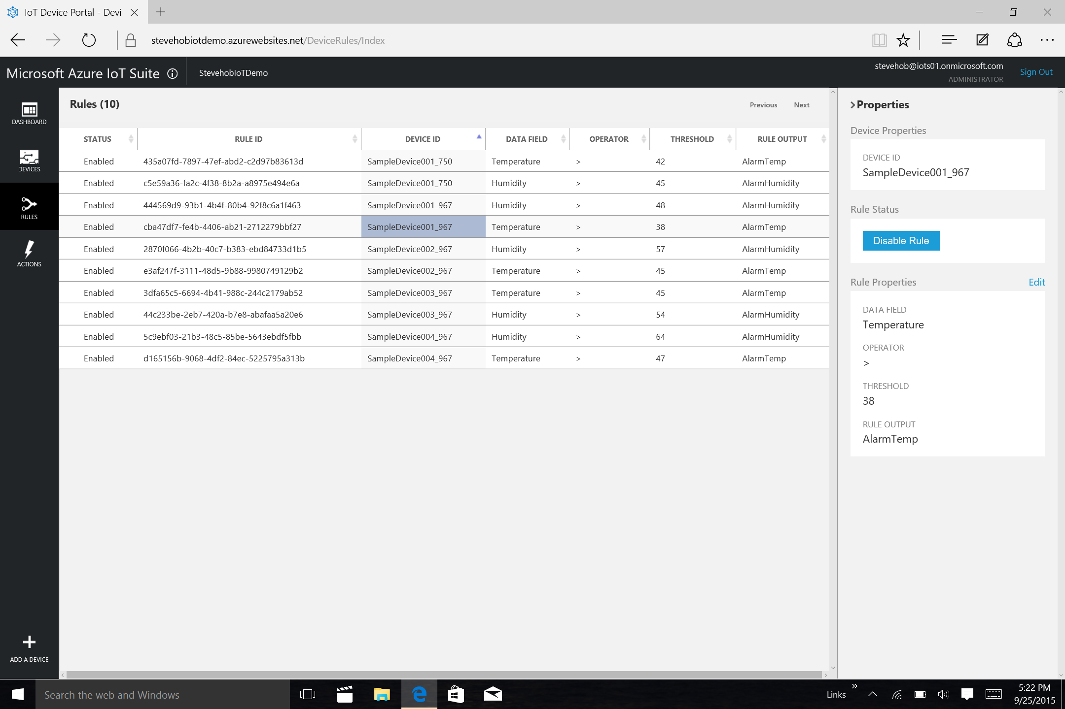
Notes:
Talking Points:
You can set a single or multiple rules to a device based on various data sets.
If you want to set a more complicated rule, so you can go under the hood and directly into event processor service (e.g. stream analytics) in Azure.
Azure IoT Suite is designed to be extensible and can be tailored to your needs.

Slide 47




















Microsoft Azure
Cloud Infrastructure
Compute
Security + Management
Networking
Hybrid Operations
Developer + App Platform
Visual Studio Family + Azure App Service
Virtual Machines
Active Directory
Express Route
Azure AD Connect Health
Containers
Multi-Factor Auth
Virtual Network
AD Privileged Identity Mgmt
Data + Analytics
Cortana Analytics Suite
Remote App
Automation
Load Balancer
Backup
Batch
Key Vault
DNS
Operational Insights
Internet of Things
Azure IoT Suite
Storage
Traffic Manager
Import/Export
Blob Storage
Azure Files
Premium Storage
VPN Gateway
StorSimple
Cloud Infrastructure
Azure + Azure Stack + Operations Management Suite
Application Gateway
Site Recovery

Slide 48

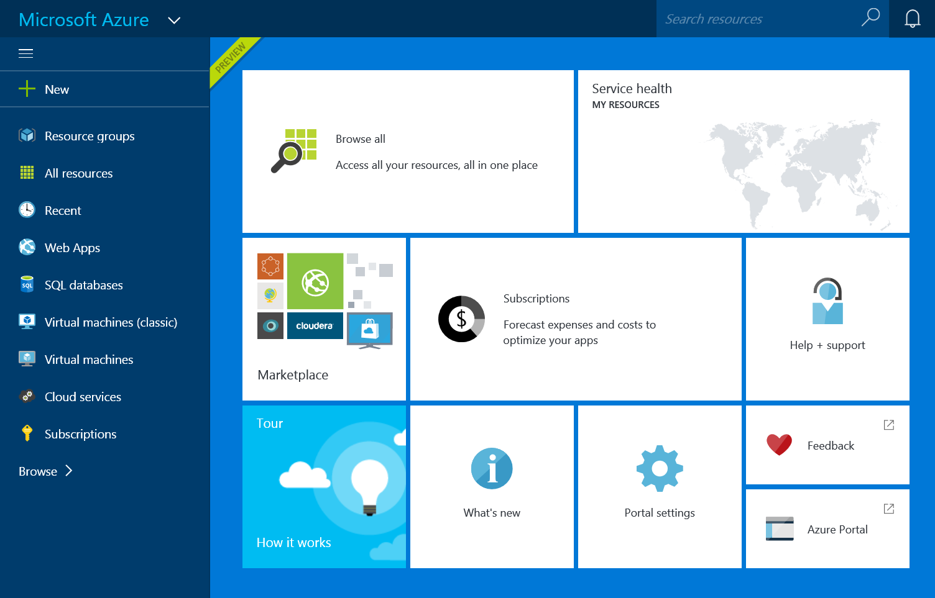
Great Infrastructure Enhancements
G
End to End Management
Premium Storage
Largest VMs in Public Cloud
Integrated management portal
Application Templates
Lifecycle Management
Role Based Access Control
Billing API
Up to 64 TB of storage per VM
>80,000 IOPS per VM
Less than 1ms read latency
Optimized for data workloads
Up to 32 CPU cores, 450 GB RAM, 6.5 TB local SSD
Latest generation Intel processor

Slide 49
New N family of virtual machines
Introducing
N
Latest NVIDIA GPU
Superfast RDMA network
High-end remote visualization

Slide 50






















































Partners

Slide 51














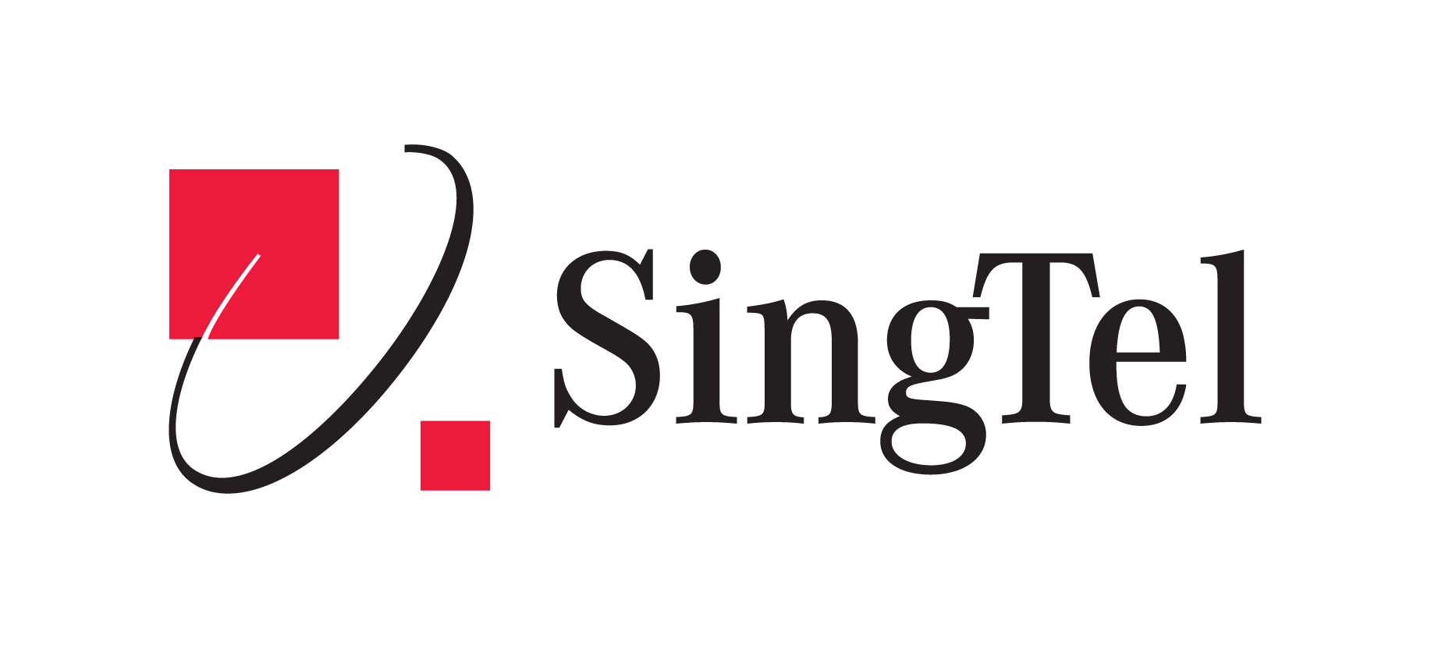





















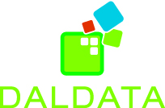

























Cloud OS Network hosting and service providers

Slide 52
Azure Services

Slide 54
Demo: Azure Portal

Slide 55
Virtual Machines
Getting started
Select image and VM size
New disk persisted in storage
Management portal
Windows Server
Boot VM from new disk
>_
Linux
Scripting
(Windows, Linux and Mac)
Blob Storage
General Purpose
Basic
Standard
Optimized Compute
Performance Optimized
Network Optimized
REST API
Cloud
Comprehensive
Networking

Slide 56
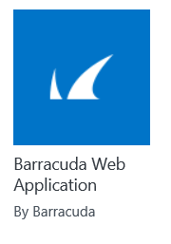
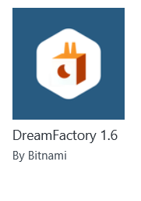
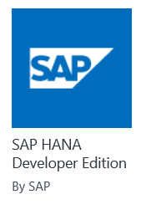
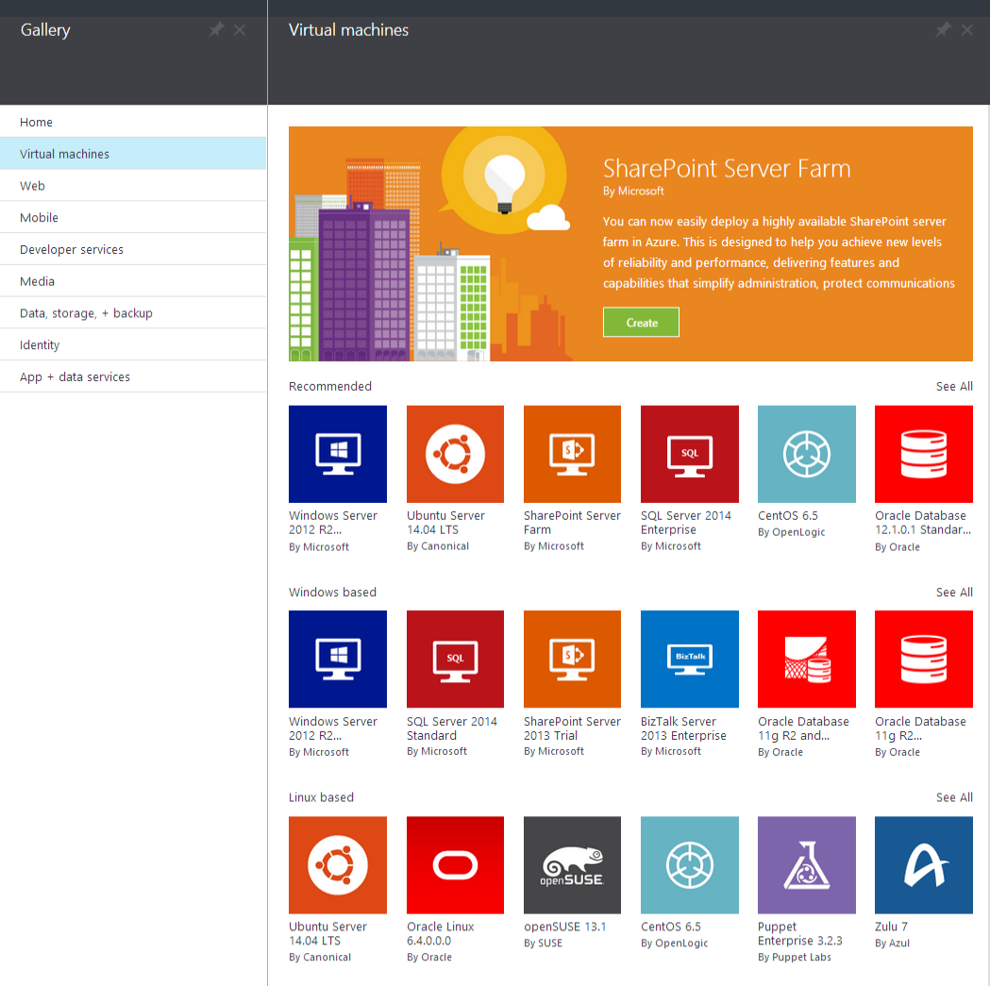

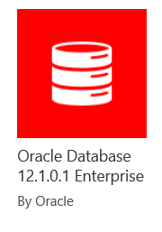
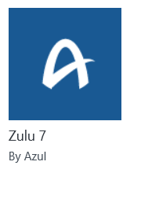
Microsoft Azure
Certified

Slide 57

Azure App Service
Preview
Web Apps
Mobile Apps
Web apps that scale with your business
Build Mobile apps for any device
LOGIC Apps
Api Apps
Automate business process across SaaS and on-premises
Easily build and consume APIs in the cloud
Notes:
App Service has everything you need to build apps that target both web and mobile clients from a single app back-end.
Using API Apps, you can connect your app to dozens of popular services like Office 365 and salesforce.com in minutes, and integrate your own APIs so they can be used within any app.
And finally with Logic Apps, you can automate business processes using a simple no-code experience.

Slide 58



Azure App Service Web Apps
Start simple
Code smart
Go live
Easily create and scale your new sites in seconds
Automatically scale your sites that scale with your business
Quickly improve performance and reduce latency with right resources
Built-in web jobs support
Leverage existing skills – Languages and databases you know
Start with open source apps and frameworks
Develop with VS and WebMatrix
Supports X-Plat development
Improve developer productivity through continuous automated deployment
Built-in monitoring of perf and usage data
Built-in diagnostics to assist with debugging
Built for DevOps
Office Blog ASP.NET site microsoft.com
Notes:
Speaker notes:
Start simple
Emphasize rapid deployment of Web Apps from choice of Asp.Net starter applications to thousands of pre-built certified, opensource, and community software applications, add-ons, and data analysis platforms pre-configured for Azure.
Explain how Web Apps use automatic load balancing to scale out.
With Web Apps its easy to scale out automatically with increasing instance count using autoscale features e.g. CPU Load, scheduled
Easily improve performance of Web Apps and reduce latency of by changing to right instance size with zero downtime
Supports cron jobs
Code smart
Leverage existing skills to start coding for Web Apps without expensive retraining:
Languages: .NET, Java, NodeJS, PHP, Python. Databases: SQL Server, MySql .
Start coding with any development tools on any platforms such as Linux, OSX and Windows.
Go live
Built for DevOps – Agility through continuous deployment.
Encourages iterative development and improves developer productivity through continuous automated deployment enabled by Web Apps’ integrated source control connectivity to Team Foundation Server(TFS) and Git.
Easily monitor key performance metrics in a verbose or minimal fashion. Easily access monitoring data from a storage account externally for further analysis.
Easily enable diagnostics logging and add instrumentation. Easy access to information logged.

Slide 59
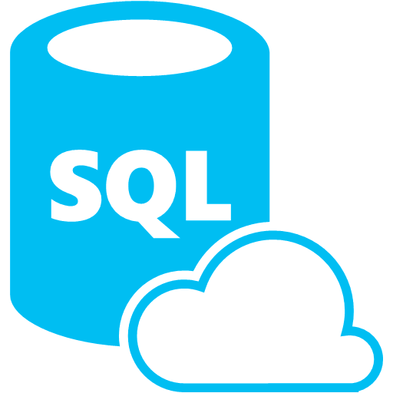






Azure App Service Mobile Apps
Provides essential services to support client development
Client Support
iOS
Android
HTML5/Web
Xamarin
Windows
Windows Phone
PhoneGap
Sencha
Storage
Authentication
Logic
Push
Scheduler
Notes:
Speaking Notes
Azure Mobile Services is a Backend-as-a-Service
Instead of you having to design, build, test, deploy, manage, and upgrade your whole backend, we do it for you
Features of Mobile Services
Storage – SQL DB
Authentication – built in support for social providers w/ ability to custom auth
Backend logic – data validation, logical flows, etc
Push Notifications – across all major mobile platforms
Scheduler – backend job processing

Slide 60
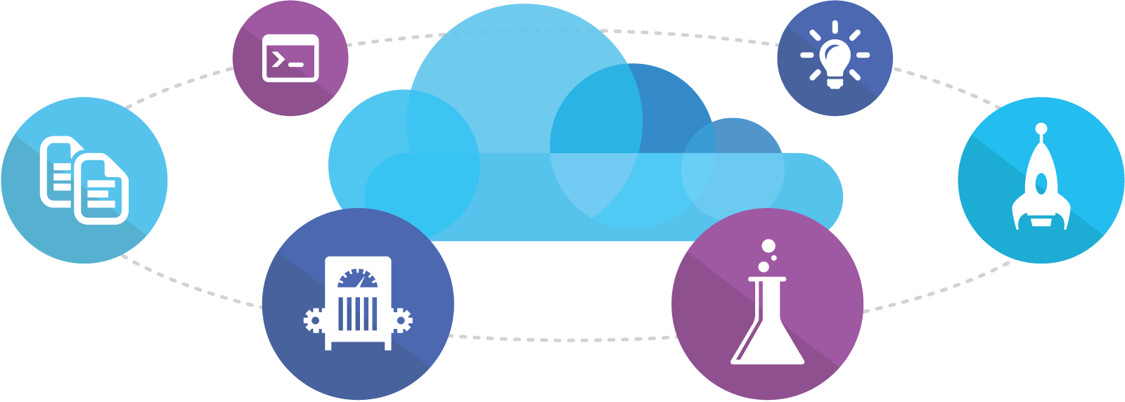
Visual Studio Online
Code
Insights
Agile
Deploy
Build
Test
Full Portal Integration
Not just for Microsoft shops

Slide 61
Demo: Azure Preview Portal

Slide 62
You
Microsoft Azure Active Directory
Synchronize your corporate and 3rd party identities
Integration with O365
Support modern protocols
OAuth 2.0
OpenID Connect
WS-Fed
SAML 2.0
Identity and Access Mgmt Permissions
Users
Groups
Applications
Microsoft Azure AD
3rd party clouds/hosting
PCs and devices

Slide 63

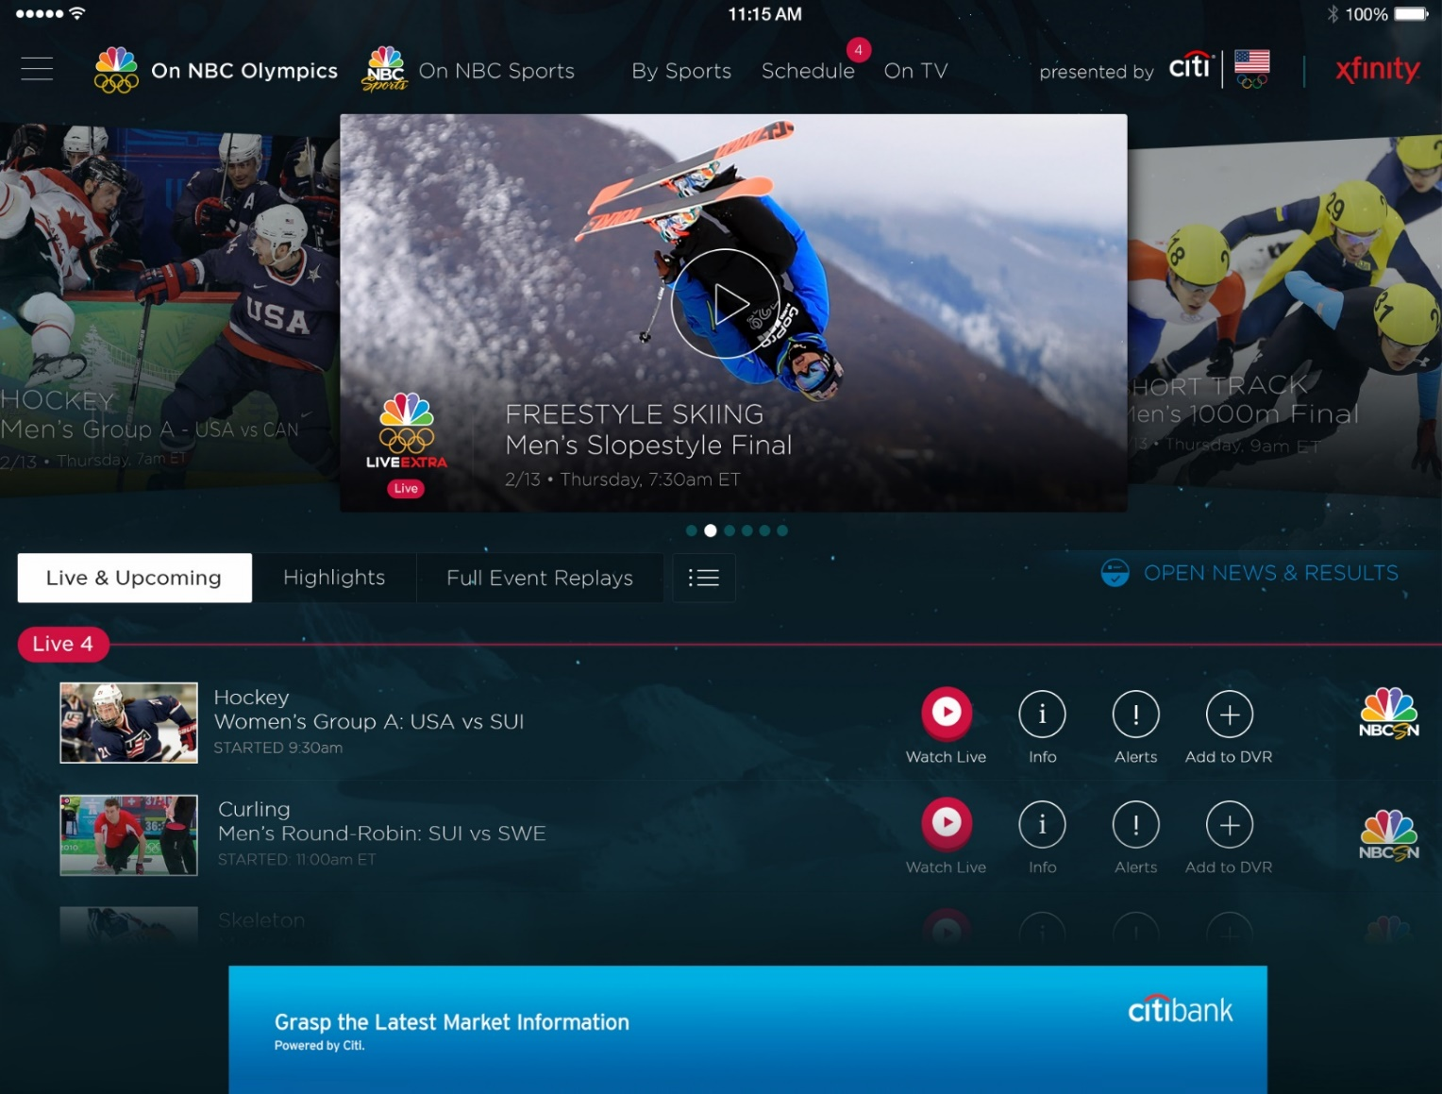
Azure Media Services
Olympics NBC Sports
On Demand Media Services
Video-on-demand
Ingest
Encode
Package
Encrypt
Delivery
Live Streaming Support
Office 365 Integration
Azure Media Player
Live video encoding and streaming
Web + Mobile
100 million viewers
2.1 million concurrent HD viewers during the USA vs. Canada hockey match
Notes:
Speaker notes:
Deliver video content or stream video to audiences large or small to any device(Web or Mobile) anywhere reliably and in scale.
Helps you create versatile media workflows for ingesting, encoding, protecting and streaming content to audiences on-demand or broadcast live.
Powerful and extensible platform with broad set of first and third-party capabilities to support complete end-to-end media workflows.
Integration with Office 365 empowers organizations of all sizes helps to use videos to enhance sharing, collaboration and communication.
Azure Media Player, an automated online player solution, supports all the usual industry standards like HTML5 video, Media Source Extensions and rights management through Encrypted Media Extensions. The focus here is on open standards, but on older browsers, the player can fall back on Flash or Silverlight.

Slide 64
Azure Data Factory
Compose and orchestrate
Connect to data of diverse shapes and location
Orchestrate processing to produce trusted data
Manage from single pane of glass
Manage a network of data pipelines
See lineage and impact analysis
Set data production policy
Retry, concurrency, late data handling
Identify and debug errors
Automatic dataset health alerts
Troubleshoot complex pipelines
AZURE DATA FACTORY
Manage and monitor
Data and operational lineage
Coordination and scheduling
Policy
DATA PIPELINES
Activity
Activity

Slide 65

Azure Stream Analytics
Event producers
Collection
Ingestor (broker)
Transformation
Long-term storage
Presentation and action
Stream Analytics
Web/thick client dashboards
Applications
Service bus
Legacy IOT (custom protocols)
Event hubs
Azure DBs
Stream processing
Search and query
Devices
Cloud gateways (web APIs)
Azure storage
IP-capable devices (Windows/Linux)
Storage adapters
HDInsight
Data analytics (Excel)
Low-power devices (RTOS)
Field gateways
Devices to take action

Slide 66
Azure Service Fabric
Rapidly develop microservice based applications
Operate reliable, scalable services
Enjoy the confidence of a battle-tested platform
Stateless or Stateful
Visual Studio tools
Focus on features not infrastructure
Rolling upgrades
Automatic Orchestration
Hybrid Operation
Self-Healing
Self-sufficient
Comprehensive
The same technology Microsoft uses
Proven more than 5 years
Investment & Roadmap

Slide 67
Key Scenarios to Get Started with Microsoft Azure

Slide 68


Key Scenarios to get started with Microsoft Azure
Full Dev/Test environments
Build
Production
Visual Studio Online
Master branch
GIT / TFS
Staging
Check-in
Test branch
Dev/Test
Developers
Notes:
Speaker notes:
Create full Dev, Test, Staging and Production environments in minutes
Availability of Visual Studio Online(VSO) integration with build option available
Validate web app changes in a staging or test deployment slot before swapping it with the production slot
Swap to get your "last known good site" instantaneously if there is a problem with a new deployment in production
Swapping to production from staging as opposed to direct deployment eliminates downtime
Dev, Test, Staging and Production deployment workflow can be automated when pre-swap validation isn’t needed

Slide 69


Key Scenarios to get started with Microsoft Azure
Microsoft SQL Server
VM
Microsoft SQL Server
VM
Microsoft Azure
Lift and Shift
Application VM
Storage
Corporate
Network
Application VM
Archive
key data inexpensively
PDF
JPG
VIDEO
DB
DOCX
Notes:
Speaker notes:
Lift and Shift
Take existing work loads and run them in a certified instance. Emphasize image mobility and Azure Files to help move applications that require SMB shared folders very easily to Azure.
Storage
Archive key data in inexpensive cloud storage. Mention corporate finance databases, industry compliance documents and other key data can be inexpensively archived to Azure storage.

Slide 70

Key Scenarios to get started with Microsoft Azure
HDInsight
Visualization
and reporting
tools
Input
Process
Results
Output
Iterative exploration - Process key data into business intelligence using Hadoop
Notes:
Speaker notes:
Iterative exploration
The source data files(log files, email messages, tweets, and more) are loaded into the cluster, processed by one or more queries within HDInsight, and the output is consumed by the chosen reporting and visualization tools. The cycle repeats using the same data until useful insights have been found, or it becomes clear that there is no useful information available from the data—in which case you might choose to restart the process with a different source dataset.

Slide 71
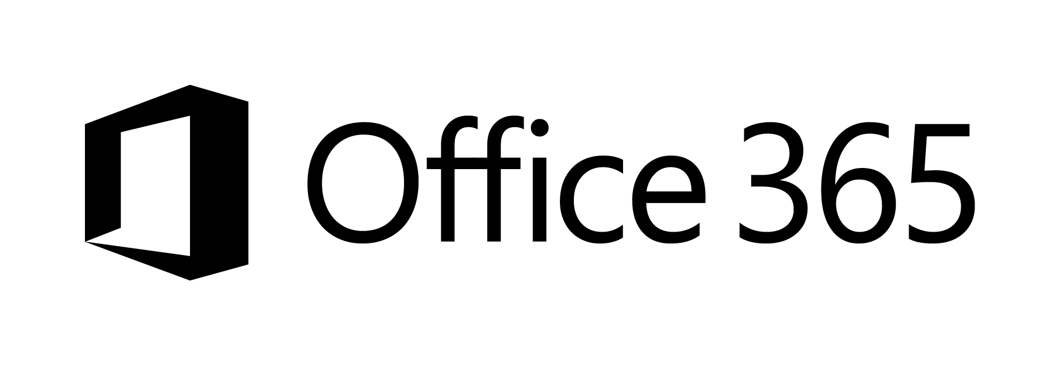





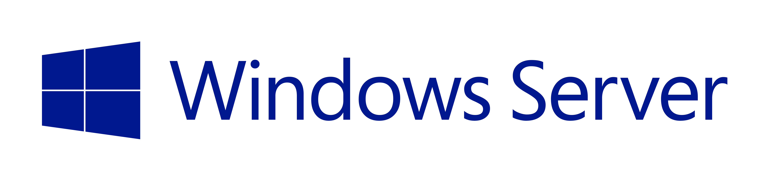


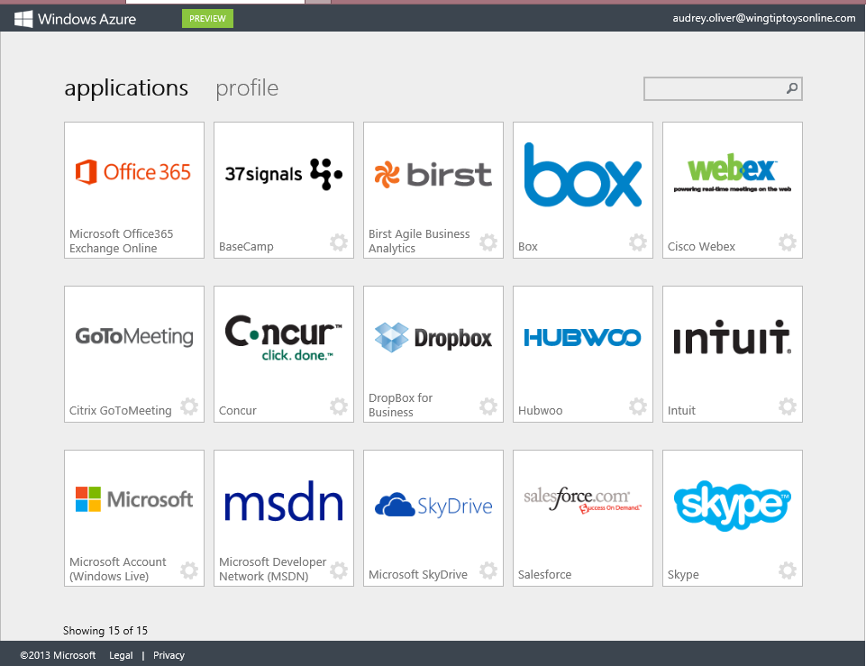
Key Scenarios to get started with Microsoft Azure
Identity as a Service
SaaS
Active Directory
Active Directory
Synchronize and
consolidate
identities
Custom LOB apps
ISV/CSV apps
Azure App Service and Non-MS cloud-based apps
PCs and devices
Notes:
Speaker notes:
Identity as a Service; Control and protect your apps, data and services in Azure together with assets in non-MS cloud using a single AD account.
Consolidate all your identities using one account for single sign-on to any cloud and on-premises services, using your favorite device, including iOS, Mac OS X, Android, and Windows devices.
As a developer you must also need to understand implications of extending your credentials in on-premises Active Directory to Azure Active Directory to protect your assets in on-premises and in the cloud.

Slide 72



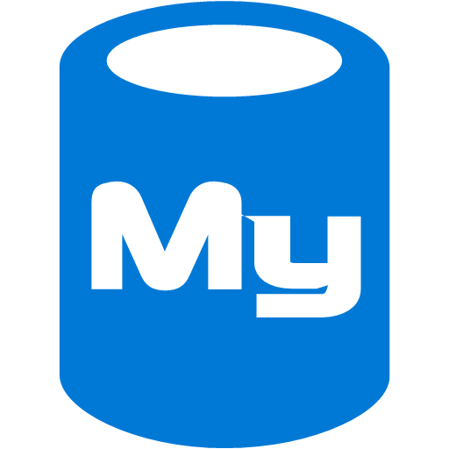



On-premises /
Hosting Services
IIS/SQL Server Based
Web Apps
Microsoft
SQL
Server
IIS
Non-IIS Open Source
Web Apps
Microsoft Azure
MySql
Web Apps - Take your web apps to the cloud using inexpensive App Service Web Apps
Key Scenarios to get started with Microsoft Azure
Notes:
Speaker notes:
You can easily move your existing IIS based web apps including SQL Server databases to Azure App Service easily with a migration tool provided by Microsoft called Azure App Service Migration Assistant.
If your open source web app’s framework is supported on App Service, the languages and frameworks needed by your application are configured for you automatically. Migrate an existing application or create a new one from the Application Gallery.
Consider using Azure Cloud Services or IaaS Virtual Machines if you are unable to migrate your application via Migration Assistant or your open source web app’s framework isn’t supported on App Service.
Other notes:
Windows Server 2003 will reach end of support on July 14th 2015. If you are currently hosting your websites on an IIS server that is Windows Server 2003, Web Apps is a low-risk, low-cost, and low-friction way to keep your websites online, and Web Apps Migration Assistant can help automate the migration process for you.
Moving to Web Apps require less time and IT expertise to configure and secure your apps compared to apps running in VM environment.
Web Apps require no maintenance effort on your part to patch, update, and manage underlying VM environment.

Slide 73
Design for Cloud

Slide 74
A different mindset
→ Embracing errors
→ Design for availability, reliability, scalability
→ Performance
Notes:
Slide Objectives:
Explain the agenda of the session.
Speaker Notes:
Explain this presentation is a high-level overview, so not everything is covered in-depth.

Slide 75
Sample architecture
WAAD
Service Bus
Paired NS
SQL Database
US West
Data Sync
Worker Role/VM
User
Internet
Traffic Manager
US East
Worker Role/VM
NoSQL DB
Geo-redundancy
CDN
Cache

Slide 76
Redundancy in Microsoft Azure
Storage Redundancy Options
SQL Database Geo-Replication
Caching with high availability option
Load-balanced App Service Apps, Cloud Service and Virtual Machines
Built-in redundancy in Azure Virtual Network gateways
Failover with Azure Traffic Manager
Notes:
Speaker notes:
Explain one or more following options for Microsoft Azure Storage redundancy: LRS, GRS and RA-GRS.
Explain how Standard and Active Geo-Replication implements a mechanism to provide Azure SQL database redundancy.
Explain various cache services available in Microsoft Azure; High availability option In-Role Cache available in Cloud Service. Redis Cache is also available as a high availability standalone cache service if you choose the standard cache offering SKU which has a 99.9% SLA. Managed Cache is not recommended.
Explain how high availability is achieved through automatic load-balanced multi-instance App Service applications, Cloud Service and Virtual Machines.

Slide 77
What does failsafe mean for my applications?
It depends… but some general practices apply.
Take advantage of Microsoft Azure features
Avoid single point of failure
Failure mode analysis
Transient errors
Graceful degradation
Eliminate human factors
Notes:
[click]
It depends, but…. [click]

Slide 78
Scaling in Microsoft Azure
Scale up by choosing different VM sizes
Scale out by adding more instances
Auto-scale with Autoscaling Application Block
Scale out by using multiple service entities
CDN to distribute user traffic
Caching to offset server workloads

Slide 79
Activate your MSDN Benefits…
+
3 VMs for 16 hrs a day
80 VMs for 20 hour load test
Up to 100 web sites + DB
Up to
$150
33%^{off}
25%^{off}
89
per Month
Dev/Test VMs
Other Dev/Test
Countries

Slide 80
Get started today at http://azure.microsoft.com

